Slide 1




Mobile e-Commerce Application
By
for

Slide 2

Presentation Outline
Meet the Team :
Who are we ?
Team Personalities Analysis
Our roles
Who is the Client and Who is the End-user ?
Reed house Systems
Egazini Outreach Project
The Challenges and Solutions
The Project :
5W+H
Analysis
Design
Development
Questions and Answers

Slide 3
Meet the Team
Project Team Member | MBTI Personality Type | Primary Role Allocated | Secondary Role Allocated
Ntsane Kolisang | ENTJ | Scrum Master | Analyst
Tsungai Makoni | ESFJ | Analyst | Designer
Abram Rankapole | ESFJ | Designer | Analyst
Dusan Gnjatic | ESTJ | Developer | Analyst
Ronald Chinku | INTJ | Developer | Designer
Giovanna Contu | ESTP | Designer | Developer

Slide 4
Who is the Client and the End User ?
Client - Reed House Systems :
Software House
Technical Liaison
End User - Egazini Outreach Project
Artists
Merchants

Slide 5
Challenges and Solutions
Find the End-User : From Dwesa to Egazini
Internal Meetings : Skype
Communication : Xhosa and English
Scope Definition : Local Database or not
Networking : Restful Webservices for Basic4Android

Slide 6
Project Objective
To project manage, develop, install, test and commission an android platform mobile application to be used by Egazini Outreach Project.

Slide 7
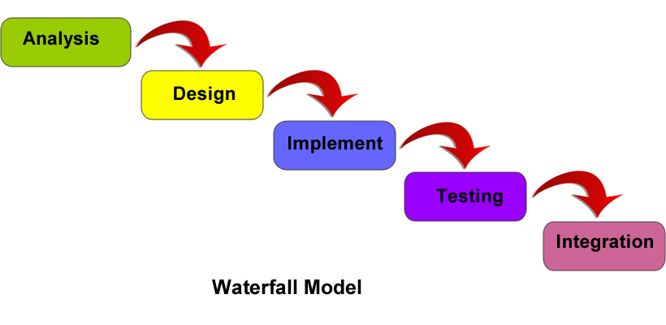
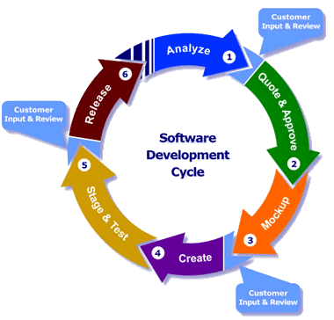
The Project Methodologies
Agile - Scrum

Slide 8
The Project : Where and Why ?
Where?
In Grahamstown
Why?
To Enable Reed house Systems clients to use their phones and upload their artwork ware to TeleWeaver and sell it to a broader market.

Slide 9
The Project : What is the Project?
Project Scope :
Develop, install, test and commission the front-end mobile application for the Reed House e-Commerce System. The application will connect to TeleWeaver using RESTful(REpresentation State Transfer) webservices.
Project work exclusion Scope:
We are not developing anything on the administrator or TeleWeaver's side.
We are not developing anything on the buyer's side.
We are not handling delivery and payment systems.

Slide 10
The Project : What is the Project?
Project Constraint :
Time : Project needs to be completed by the end of October 2013
Resources :
Team Size
Team capability (knowledge, skills, experience)
Development Software and support
Mobile Platform (Android)
Access to Information

Slide 11
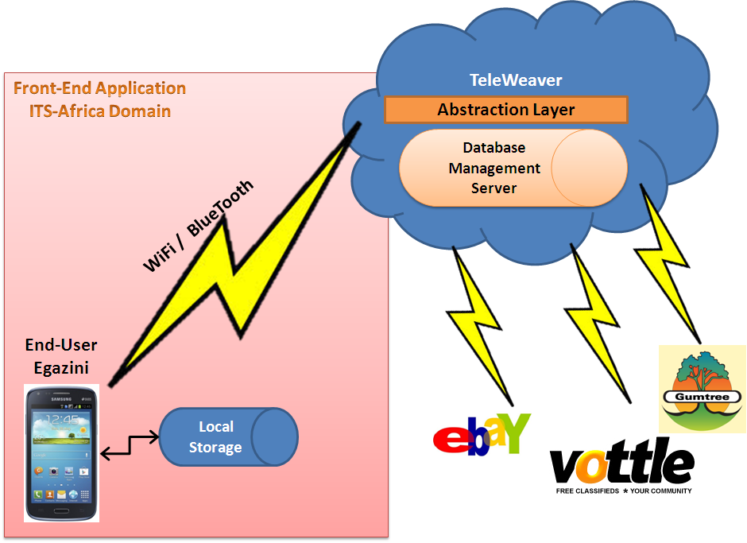
FOR CLARITY
Network Architecture Diagram - Our Operation

Slide 12
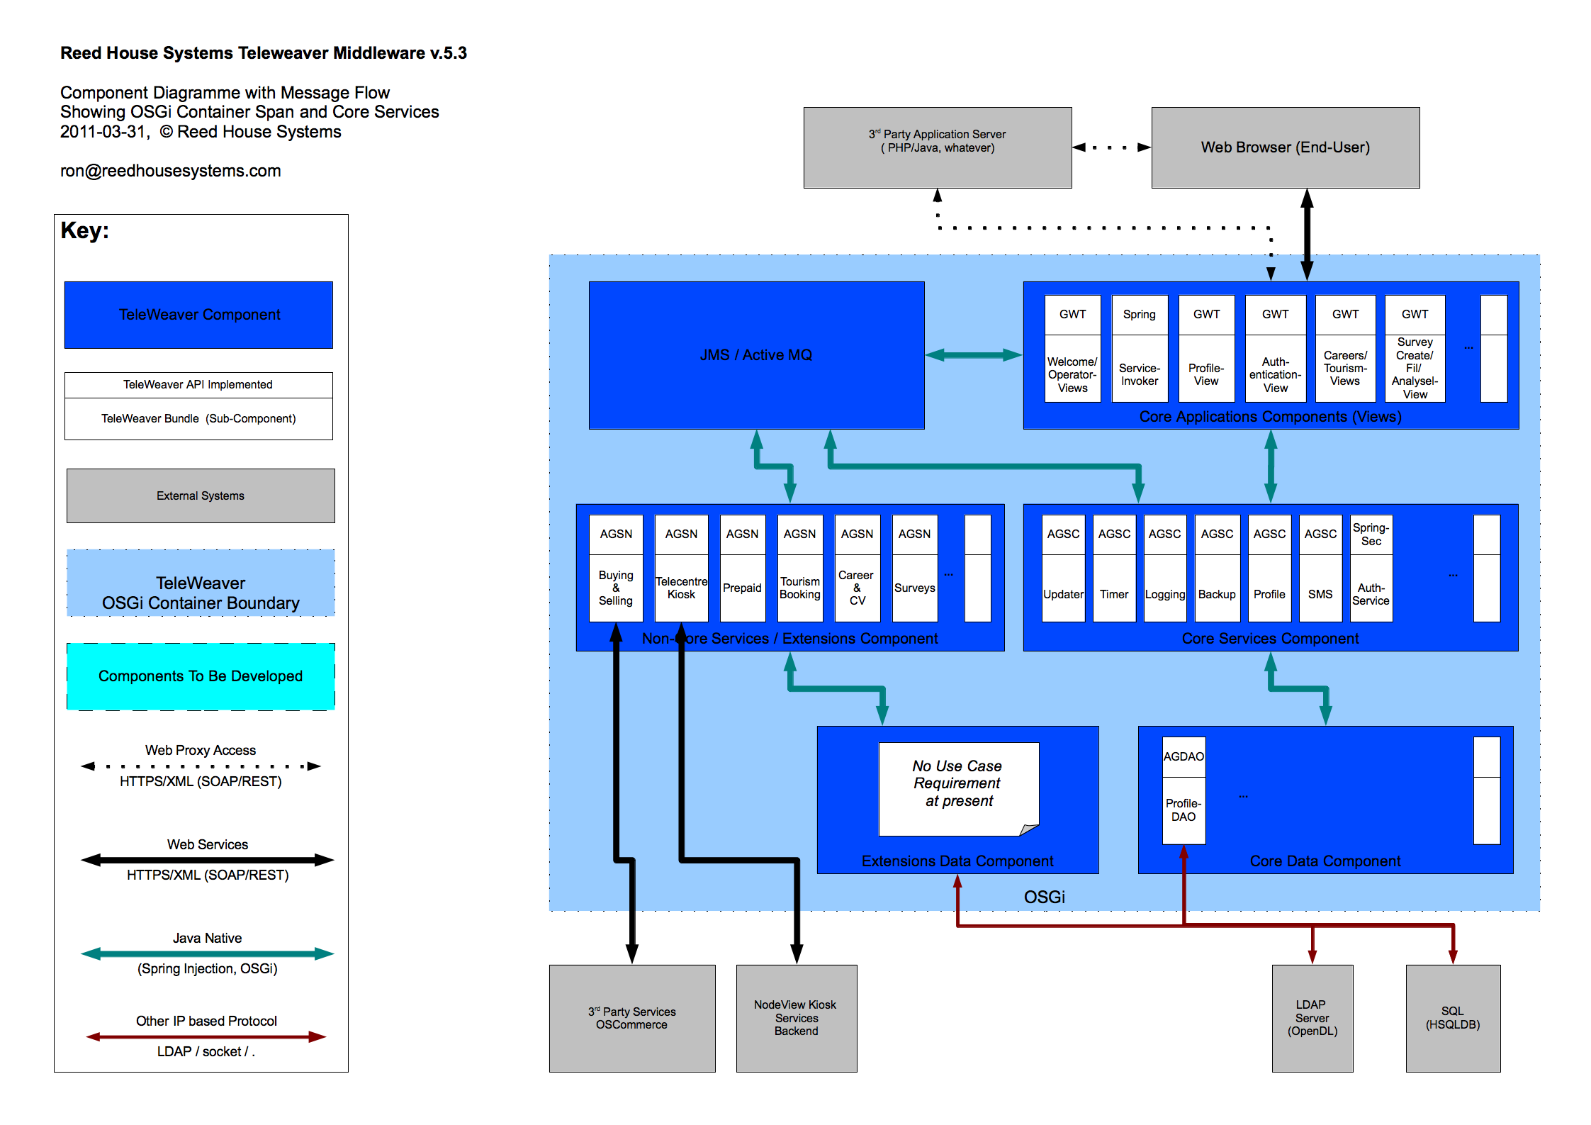
FOR YOUR CLARITY

Slide 13
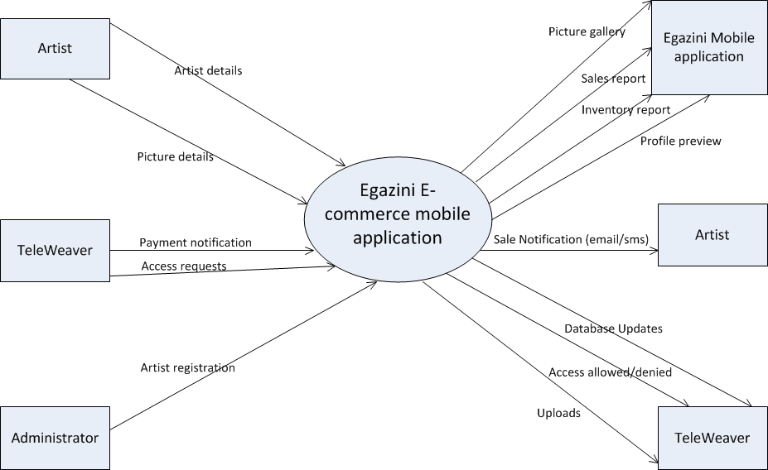
Context Diagram

Slide 14
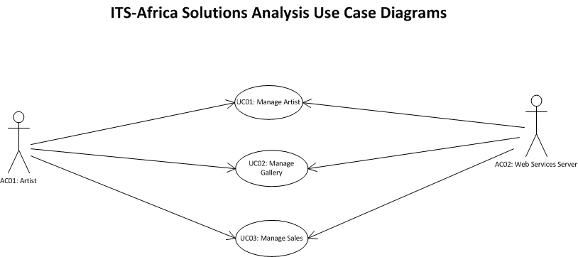
Use Case Diagram

Slide 15
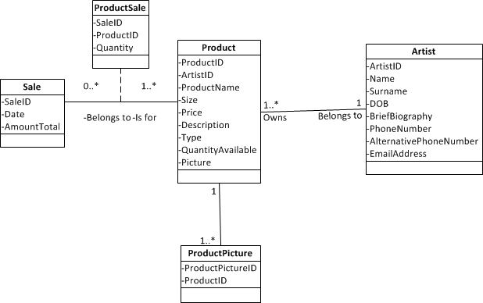
Class Diagram

Slide 16
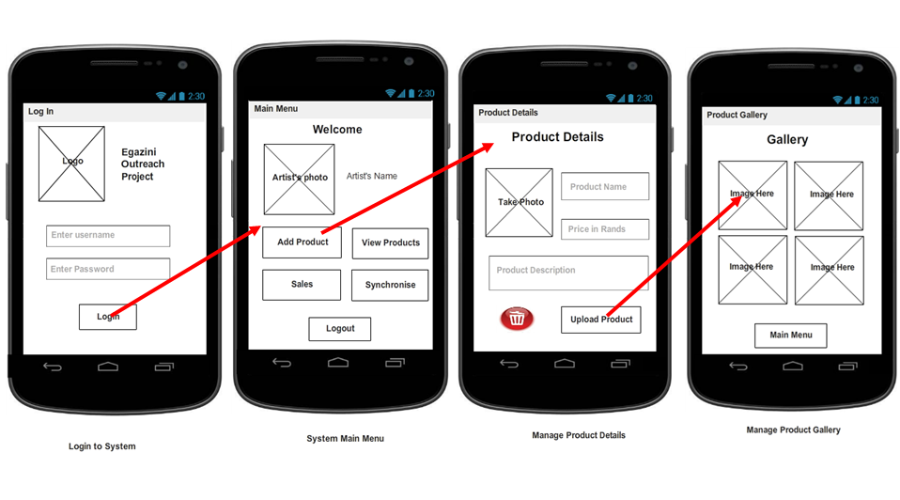
User Interface Design: Storyboard

Slide 17
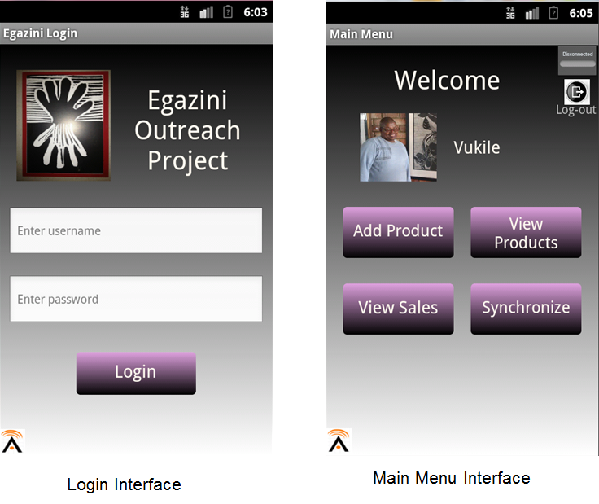
User Interface Design: Screen Mock ups

Slide 18

Live Demonstration
Product Development
Platform - Basic4Android
Type of phone used
Prototype Demonstration

Slide 19
THINGS TO ADDRESS
Application name and iconography.
Integrating Basic4Android to a database.
Creating a RESTfull client webservice.

Slide 20
Q&A
Questions and Answers

